Slide 1
History of the atom

Slide 2

We now know that everything around us is made up of tiny particles called atoms. But if atoms are so small that we cannot see them, how do we know so much about them?

Slide 3
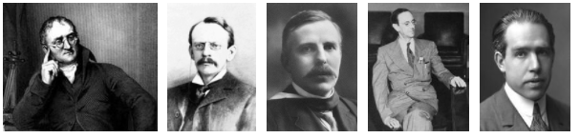
Before we understood very much at all about atoms, some very clever scientists came up with different models to describe their structure and behaviour.
A model is a representation of a system that can help us to understand it. In this Smart Lesson, you will learn all about the different models, and the experiments conducted, that led to our current understanding of atomic structure.

Slide 4

Most of these scientists built on each others' ideas to develop their models. In science, ideas are continually developing. We can never claim to know everything about the world we live in, which is why there are still so many scientists around today.
Our current model of the atom will likely prove to be incorrect when new scientific discoveries are made - maybe they will be made by you!

Slide 5
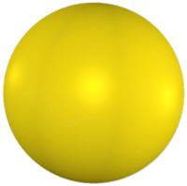
The idea of atoms was first proposed by Democritus, a Greek philosopher, in 460BC.
Democritus thought that atoms were tiny, solid spheres with no smaller particles within them.
He correctly predicted that atoms could not be destroyed.
Because atoms are far too small to be seen, his ideas were dismissed and ignored for more than 2000 years.

Slide 6
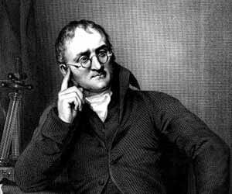
John Dalton came up with the atomic theory in 1808, after examining the work of other chemists and doing his own experiments. He concluded that Democritus was correct in that matter was made up of tiny separate particles.

Slide 7
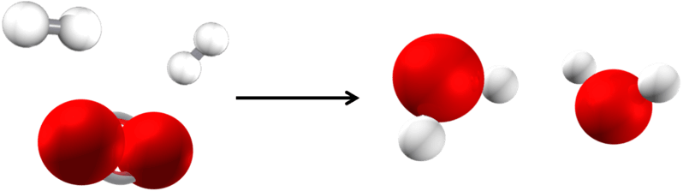
The main ideas of Dalton's theory were:
1. All matter is composed of indivisible atoms.
2. All the atoms of a given element are identical.
3. The atoms of different elements have different masses.
4. Atoms always preserve their identity in chemical reactions.

Slide 8
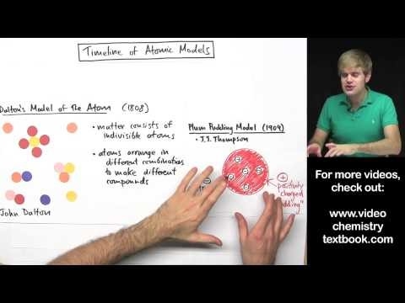

Slide 9
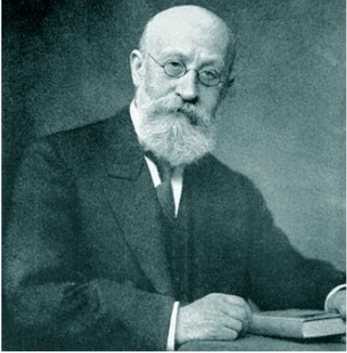
Eugen Goldstein was a German physicist who studied electrical discharges in vacuums. Through this work, in 1886 he discovered positive ions, which he realised had the opposite charge to electrons. His work suggested the presence of protons, which were later formally discovered by Ernest Rutherford.

Slide 10
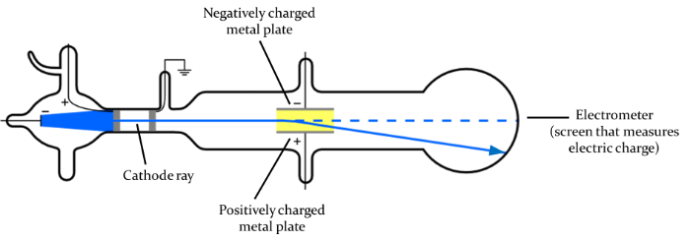
Electrons were discovered in 1897 by J. J. Thomson, who carried out a cathode ray experiment.
It was already known that when an electrical current was passed through a vacuum, a stream of glowing materials could be seen. This stream is called a cathode ray. Thomson discovered that the cathode ray could be bent by electrical and magnetic fields.
This led Thomson to conclude that the stream was made of negatively charged particles which were later called electrons.

Slide 11


Slide 12
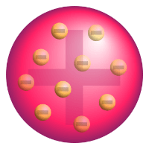
After Thomson discovered electrons, he proposed a model of the atom that is now called the plum pudding model.
This model has negatively charged electrons scattered evenly throughout a positive sphere.
Thomson knew that atoms were electrically neutral so he thought atoms must have the positive sphere to cancel out the negative electrons. This was the first evidence that atoms were made up of even smaller particles.

Slide 13
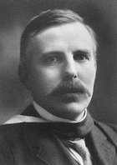
Protons were discovered by Ernest Rutherford. He carried out a gold foil experiment in 1911.
In this experiment, Rutherford fired positive alpha particles at a very thin sheet of gold foil. Alpha particles are a type of radiation made up of two protons and two neutrons. You will learn more about them in a later Smart Lesson.

Slide 14
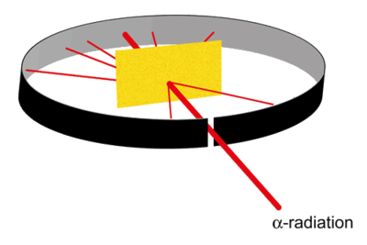
If Thomson's model of the atom was correct, the alpha particles should have gone straight through the foil without being deflected at all. Most of the particles did pass through the gold foil without changing direction. However, some of the particles were slightly deflected, and a few of particles were deflected straight back!

Slide 15
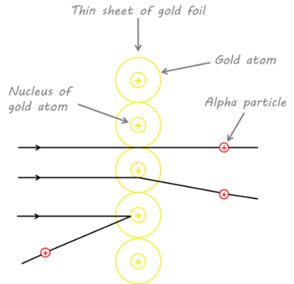
Rutherford's experiment led him to conclude that a small, dense mass exists at the centre of every atom. He called this the nucleus.
Since some of the alpha particles were deflected directly back, the nucleus must be very dense. It also must be positively charged in order to repel the positively charged alpha particles. Rutherford called the positively charged particles in the nucleus protons.

Slide 16
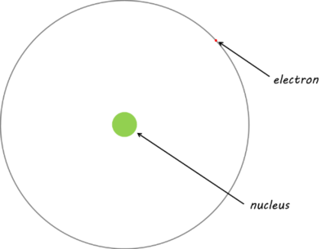
Since most of the alpha particles were not deflected at all by the nucleus, Rutherford concluded that the nucleus was very small. This means that most of an atom is empty space.

Slide 17
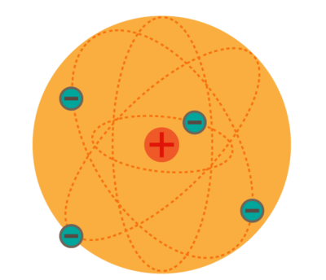
After discovering the nucleus, Rutherford proposed the solar system model of the atom.
In this model, the negatively charged electrons orbit around the nucleus which contains positively charged protons.

Slide 18
Rutherford believed that the electrons orbited this newly discovered nucleus, like planets around a sun.
We're getting closer to the modern model, however Rutherford's model couldn't explain how these orbits remained stable for so long. Electrons travel at the speed of light, so their orbit would spiral into the nucleus within seconds.

Slide 19
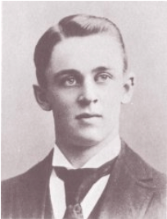
Robert Millikan was an American Physicist, who received a Nobel Prize in {1923}1923 for his work determining the charge of a single electron, and his research into the photoelectric effect.
He used the oil drop experiment in 1909 to work out the charge on a single electron. Basically oil was dropped between two metal plates and an increasing charge applied, until the force of gravity balanced the force of electrical repulsion, and the drop remained suspended between the plates. This experiment was repeated many times for different sized drops. Each charge was a multiple of the charge on a single electron, which was then calculated.

Slide 20
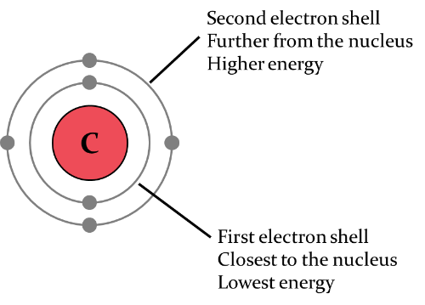
Niels Bohr proposed a new atomic model which improved on Rutherford's model. We call this the Rutherford-Bohr Model.
Bohr proposed that electrons existed in energy states. This means that they can only have certain amounts of energy. When electrons are in their energy states, called their orbitals, they would not lose energy.
The orbital (also known as the electron shell) closest to the nucleus has the lowest energy. Orbitals further from the nucleus have higher energy. The further an electron is from the nucleus, the less attraction to the nucleus it experiences. This means that the electrons in the furthest orbital, known as valence electrons, are those that react with other atoms.

Slide 21
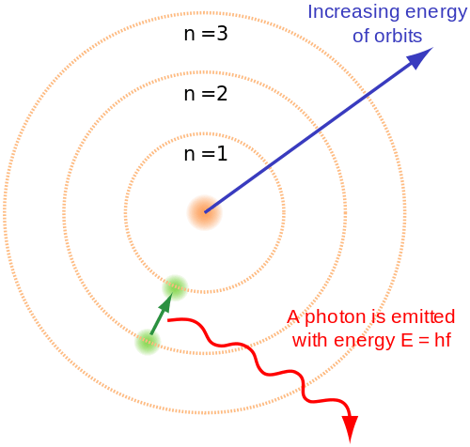
To summarise the Rutherford-Bohr model:
• | electrons are in orbitals which correspond to energy states.
• | there is a dense, positive nucleus.
• | most of the atom is empty space.

Slide 22
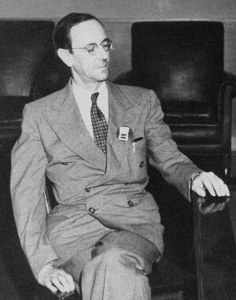
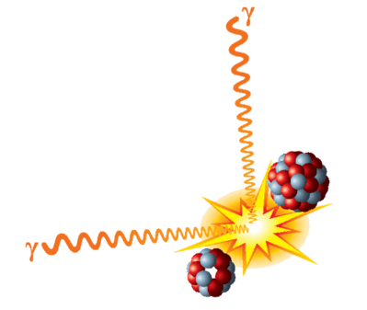
Neutrons were discovered by one of Rutherford's students, James Chadwick, in 1932.
Chadwick reasoned that a neutral subatomic particle must exist in the nucleus of the atom. This was because if there was nothing else in the nucleus the positive protons would repel each other, ripping the nucleus apart.

Slide 23
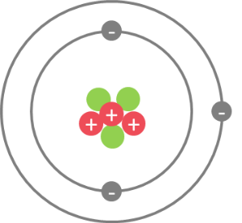
Chadwick's discovery of neutrons led to the development of the Chadwick-Bohr model of the atom, which is the model commonly used today.
This model has protons and neutrons making up a positively charged nucleus, and electrons orbiting around the nucleus in specific energy levels called orbitals. Each orbital holds a certain number of electrons.

